Slide 1
Data Sets and Proper Statistical Analysis of Data Mining Techniques

Slide 2
Data Sets and Proper Statistical Analysis of Data Mining Techniques
Data Sets and Partitions
Using Statistical Tests to Compare Methods
  Conditions for the Safe Use of Parametric Tests
  Normality Test over the Group of Data Sets and Algorithms
  Non-parametric Tests for Comparing Two Algorithms in Multiple Data Set Analysis
  Non-parametric Tests for Multiple Comparisons Among More than Two Algorithms

Slide 3
Data Sets and Proper Statistical Analysis of Data Mining Techniques
Data Sets and Partitions
Using Statistical Tests to Compare Methods
  Conditions for the Safe Use of Parametric Tests
  Normality Test over the Group of Data Sets and Algorithms
  Non-parametric Tests for Comparing Two Algorithms in Multiple Data Set Analysis
  Non-parametric Tests for Multiple Comparisons Among More than Two Algorithms

Slide 4
Data Sets and Partitions
The ultimate goal of any DM process is to be applied to real life problems
Testing a technique in every problem is unfeasible
The common procedure is to evaluate such a technique in a set of standard DM problems (or data sets) publicly available

Slide 5
Data Set Partitioning
The benchmark data sets are used with one goal:
To evaluate the performance of a given model over a set of well-known standard problems
However the data must be correctly used in order to avoid bias in the results

Slide 6
Data Set Partitioning
If the whole data set is used for both build and validate the model generated by a ML algorithm we have no clue about how the model will behave with new, unseen cases
Two main problems may arise by using the same data to train and evaluate the model:
  Underfitting happens when the model is poorly adjusted to the data, suffering from high error both in training and test (unseen) data
  Overfitting happens when the model is too tightly adjusted to data offering high precision to known cases but behaving poorly with unseen data.

Slide 7
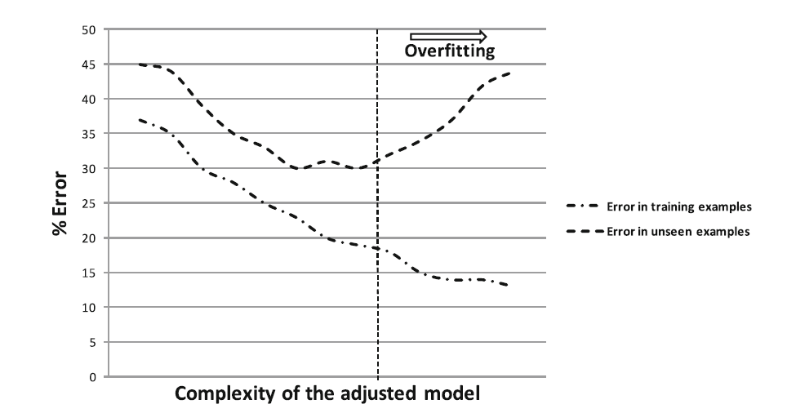
Data Set Partitioning

Slide 8
Data Set Partitioning
By using the whole data we may be aware of underfitting problems due to a low performance of the model.
  The lack of data will also cause underfitting
Adjusting such a model to better fit the data may lead to overfitting
  the lack of unseen case makes impossible to notice this situation
  Overfitting may also appear due other reasons like noise

Slide 9
Data Set Partitioning
In order to:
  control the model’s performance
  avoid overfitting
  to have a generalizable estimation of the quality of the model obtained
several partitioning schemes are introduced in the literature
How to partition the data is a key issue as it will largely influence in the performance of the methods
Performing a bad partitioning will surely lead to incomplete and/or biased behavior about the model being evaluated.

Slide 10
Data Set Partitioning: k-FCV
The most common one is k-Fold Cross Validation (k-FCV):
  In k-FCV, the original data set is randomly partitioned into k equal size folds or partitions
  From the k partitions, one is retained as the validation data for testing the model, and the remaining k − 1 subsamples are used to build the model.
  As we have k partitions, the process is repeated k times with each of the k subsamples used exactly once as the validation data.

Slide 11
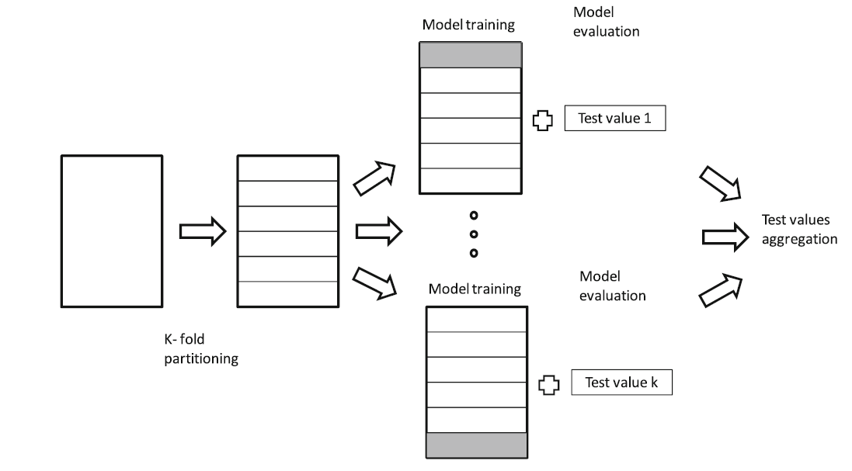
Data Set Partitioning: k-FCV

Slide 12
Data Set Partitioning: k-FCV
The value of k may vary, 5 and 10 being the most common ones
k needs to be adjusted to avoid to generate a small test partition poorly populated with examples that may bias the performance measures used.
  If big data sets are being used, 10-FCV is usually utilized
  For smaller data sets 5-FCV is more frequent

Slide 13
Data Set Partitioning: k-FCV
Simple k-FCV may also lead to disarranging the proportion of examples from each class in the test partition
The most commonly employed method in the literature to avoid this problem is stratified k-FCV
  It places an equal number of samples of each class on each partition to maintain class distributions equal in all partitions

Slide 14
Data Set Partitioning: 5×2 CV
The whole data set is randomly partitioned in two subsets A and B.
  The model is first built using A and validated with B
  Then the process is reversed with the model built with B and tested with A
This partitioning process is repeated as desired
  the performance measure in each step is aggregated every time the process is repeated

Slide 15
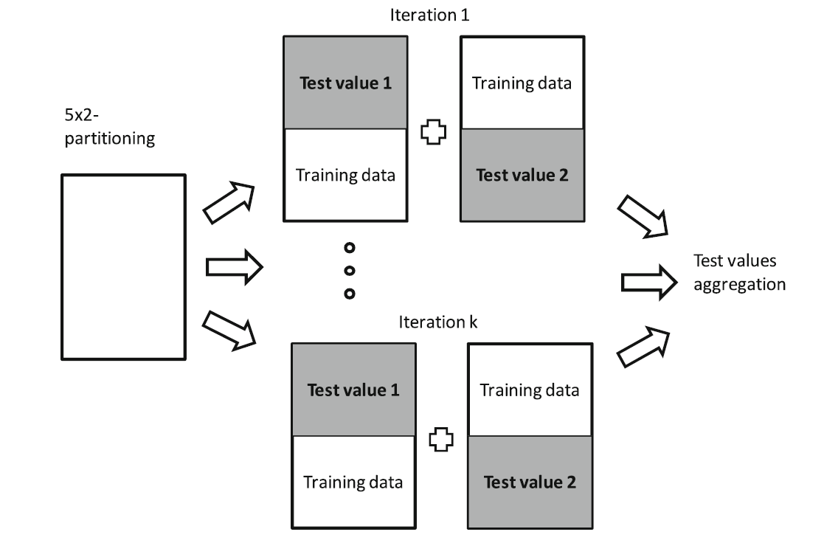
Data Set Partitioning: 5×2 CV

Slide 16
Data Set Partitioning: Leave one out
Is an extreme case of k-FCV → k equals the number of examples in the data set
In each step only one instance is used to test the model whereas the rest of instances are used to learn it.

Slide 17
Performance Measures
Predictive processes like classification and regression rely in a measure of how well the model fits the data
In classification literature we can observe that most of the performance measures are designed for binary-class problems
Well-known accuracy measures for binary-class problems are classification rate, precision, sensitivity, specificity, G-mean, F-score, AUC, Youden’s index γ and Cohen’s Kappa

Slide 18
Performance Measures
Some of the two-class accuracy measures have been adapted for multi-class problems.
An example is approximating multi-class ROC analysis
  is theoretically possible but its computation is still restrictive
Only two measures are widely used because of their simplicity and successful application when the number of classes is large enough
  Classification rate (also known as accuracy): is the number of successful hits relative to the total number of classifications
  Cohen’s kappa

Slide 19
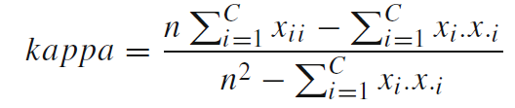
Performance Measures
Cohen’s kappa is an alternative to classification rate, a method, known for decades, that compensates for random hits. Using the resulting confusion matrix, Cohen’s kappa measure can be obtained using the following expression:
Cohen’s kappa ranges from −1 (total is agreement) through 0 (random classification) to 1 (perfect agreement)

Slide 20
Data Sets and Proper Statistical Analysis of Data Mining Techniques
Data Sets and Partitions
Using Statistical Tests to Compare Methods
  Conditions for the Safe Use of Parametric Tests
  Normality Test over the Group of Data Sets and Algorithms
  Non-parametric Tests for Comparing Two Algorithms in Multiple Data Set Analysis
  Non-parametric Tests for Multiple Comparisons Among More than Two Algorithms

Slide 21
Using Statistical Tests to Compare Methods
Using the raw performance measures to compare different ML methods and to establish a ranking is discouraged
Other tools of statistical nature must be utilized in order to obtain meaningful and durable conclusions
In recent years, there has been a growing interest for the experimental analysis in the field of DM

Slide 22
Data Sets and Proper Statistical Analysis of Data Mining Techniques
Data Sets and Partitions
Using Statistical Tests to Compare Methods
  Conditions for the Safe Use of Parametric Tests
  Normality Test over the Group of Data Sets and Algorithms
  Non-parametric Tests for Comparing Two Algorithms in Multiple Data Set Analysis
  Non-parametric Tests for Multiple Comparisons Among More than Two Algorithms

Slide 23
Conditions for the Safe Use of Parametric Tests
The distinction between parametric and non-parametric tests is based on the level of measure represented by the data to be analyzed
A parametric test usually uses data composed by real values
However the latter does not imply that when we always dispose of this type of data, we should use a parametric test
  Other initial assumptions for a safe usage of parametric tests must be fulfilled
  The non fulfillment of these conditions might cause a statistical analysis to lose credibility

Slide 24
Conditions for the Safe Use of Parametric Tests
The following conditions are needed in order to safely carry out parametric tests:
  Independence: In statistics, two events are independent when the fact that one occurs does not modify the probability of the other one occurring.
  Normality: An observation is normal when its behaviour follows a normal or Gauss distribution with a certain value of average μ and variance σ.
  Heteroscedasticity: This property indicates the existence of a violation of the hypothesis of equality of variances.

Slide 25
Conditions for the Safe Use of Parametric Tests
With respect to the independence condition, Demsˇar suggests that independency is not truly verified in k-FCV and 5×2CV.
Hold-out partitions can be safely take as independent, since training and tests partitions do not overlap.
The independence of the events in terms of getting results is usually obvious, given that they are independent runs of the algorithm with randomly generated initial seeds

Slide 26
Conditions for the Safe Use of Parametric Tests
Three normality tests are usually used in order to check whether normality is present or not:
  Kolmogorov–Smirnov: compares the accumulated distribution of observed data with the accumulated distribution expected from a Gaussian distribution.
  Shapiro–Wilk: analyzes the observed data to compute the level of symmetry and kurtosis (shape of the curve) in order to compute the difference with respect to a Gaussian distribution afterwards.
  D’Agostino–Pearson: first computes the skewness and kurtosis to quantify how far from Gaussian the distribution is in terms of asymmetry and shape. It then calculates how far each of these values differs from the value expected with a Gaussian distribution.

Slide 27
Conditions for the Safe Use of Parametric Tests
Levene’s test is used for checking whether or not k samples present this homogeneity of variances (homoscedasticity).
When observed data does not fulfill the normality condition, this test’s result is more reliable than Bartlett’s test, which checks the same property.

Slide 28
Data Sets and Proper Statistical Analysis of Data Mining Techniques
Data Sets and Partitions
Using Statistical Tests to Compare Methods
  Conditions for the Safe Use of Parametric Tests
  Normality Test over the Group of Data Sets and Algorithms
  Non-parametric Tests for Comparing Two Algorithms in Multiple Data Set Analysis
  Non-parametric Tests for Multiple Comparisons Among More than Two Algorithms

Slide 29
Normality Test over the Group of Data Sets and Algorithms
Let us consider an small case of study
  a small set of 6 well-known classification problems
  10-FCV as a validation scheme
  MLP as a classifier
  5 runs
Please note that using a k-FCV will mean that independence is not held but it is the most common validation scheme used in classification so this study case turns out to be relevant

Slide 30
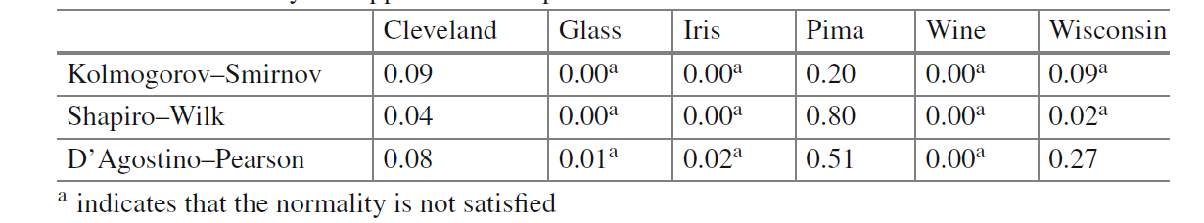
Normality Test over the Group of Data Sets and Algorithms
We want to check if our samples follow a normal distribution:
As we can observe, in many cases the normality assumption is not held (indicated by an “a” in the table).

Slide 31
Normality Test over the Group of Data Sets and Algorithms
Q-Q graphics can be also used to represent a confrontation between the quartiles from data observed and those from the normal distributions.
Complemented with histograms of the data, the normality can be visually checked

Slide 32
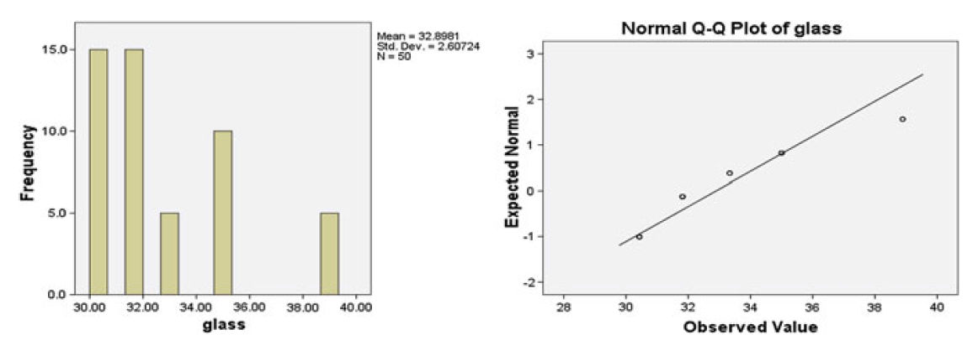
Normality Test over the Group of Data Sets and Algorithms
A general case in which the property of abnormality is clearly presented

Slide 33
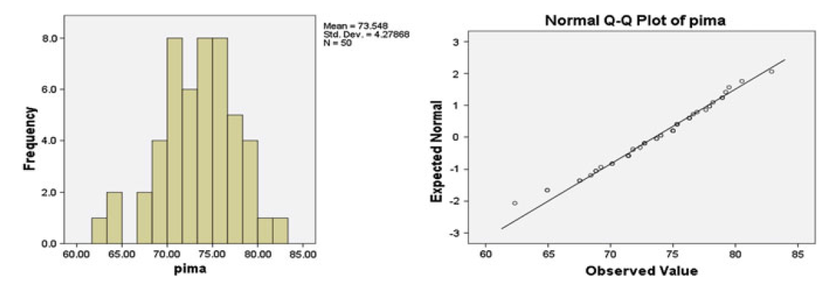
Normality Test over the Group of Data Sets and Algorithms
A sample whose distribution follows a normal shape, and the three normality tests employed verified this

Slide 34
Normality Test over the Group of Data Sets and Algorithms
The non fulfillment of the normality and homoscedasticity conditions is perfectible.
In most functions, the normality condition is not verified in a single-problem analysis
  The homoscedasticity is also dependent of the number of algorithms studied
A sample of 50 results that should be large enough to fulfill the parametric conditions does not always verify the necessary precepts for applying parametric tests, as we could see in the previous section.
For all these reasons, the use of non-parametric test for comparing ML algorithms is recommended

Slide 35
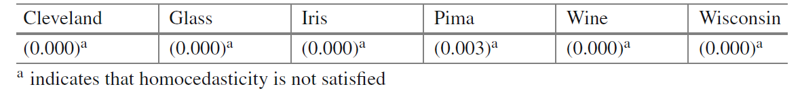
Normality Test over the Group of Data Sets and Algorithms
The third condition needing to be fulfilled is heteroscedasticity
Applying Levene’s test to the samples of the six data sets results in the following table
The non fulfillment of the normality and homoscedasticity conditions is perfectible.

Slide 36
Data Sets and Proper Statistical Analysis of Data Mining Techniques
Data Sets and Partitions
Using Statistical Tests to Compare Methods
  Conditions for the Safe Use of Parametric Tests
  Normality Test over the Group of Data Sets and Algorithms
  Non-parametric Tests for Comparing Two Algorithms in Multiple Data Set Analysis
  Non-parametric Tests for Multiple Comparisons Among More than Two Algorithms

Slide 37
Normality Test over the Group of Data Sets and Algorithms
ML approaches have been compared through parametric tests by means of paired t tests
In some cases, the t test is accompanied with the non-parametric Wilcoxon test applied over multiple data sets
Their use is correct when we are interested in finding the differences between two methods
  they must not be used when we are interested in comparisons that include several methods.

Slide 38
Normality Test over the Group of Data Sets and Algorithms
In the case of repeating pairwise comparisons, there is an associated error that grows as the number of comparisons done increases
It is the family-wise error rate (FWER)
  It is the probability of at least one error in the family of hypotheses
To solve this problem, some authors use the Bonferroni correction for applying paired t test although is not recommended.

Slide 39
Wilcoxon Signed-Ranks Test
It is the analogue of the paired t-test in non-parametric statistical procedures
It is a pairwise test that aims to detect significant differences between two sample means
  i.e. the behavior of two algorithms

Slide 40
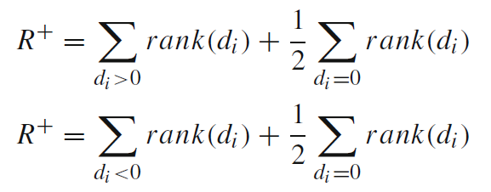
Wilcoxon Signed-Ranks Test
Let d_{i} be the difference between the performance scores of the two classifiers on i^{th} out of N_{ds} data sets
The differences are ranked according to their absolute values
  average ranks are assigned in case of ties
Let R⁺ be the sum of ranks for the data sets onwhich the first algorithm outperformed the second, and R⁻ the sum of ranks for the opposite

Slide 41
Wilcoxon Signed-Ranks Test
Let T be the smaller of the sums
  T = min(R⁺, R⁻)
If T is less than or equal to the value of the distribution of Wilcoxon for Nds degrees of freedom the null hypothesis of equality of means is rejected.

Slide 42
Wilcoxon Signed-Ranks Test
Wilcoxon signed ranks test is more sensible than the t-test
  It assumes commensurability of differences, but only qualitatively
  Greater differences still count more, which is probably desired, but the absolute magnitudes are ignored
From the statistical point of view, the test is safer since it does not assume normal distributions

Slide 43
A Case Study: Performing Pairwise Comparisons
We will perform the statistical analysis by means of pairwise comparisons by using the results of performance measures obtained by the algorithms MLP, RBFN, SONN and LVQ
In order to compare the results between two algorithms and to stipulate which one is the best, we can perform a Wilcoxon signed-rank test
This statement must be enclosed by a probability of error, that is the complement of the probability of reporting that two systems are the same, called the p value

Slide 44
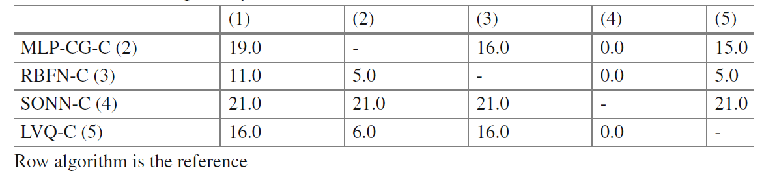
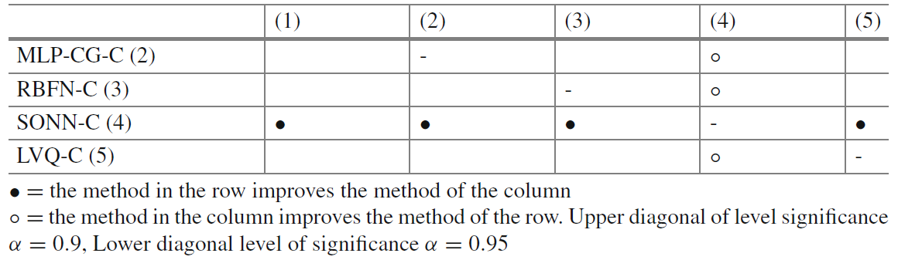
A Case Study: Performing Pairwise Comparisons
Ranks obtained
Results from Wilcoxon’s test

Slide 45
A Case Study: Performing Pairwise Comparisons
The comparisons performed in this study are independent, so they never have to be considered in a whole
If we try to extract a conclusion which involves more than one comparison from the previous tables,wewill lose control of the FWER
  The statement: “SONN obtains a classification rate better than RBFN, LVQ and MLP algorithms with a p value lower than 0.05” is incorrect

Slide 46
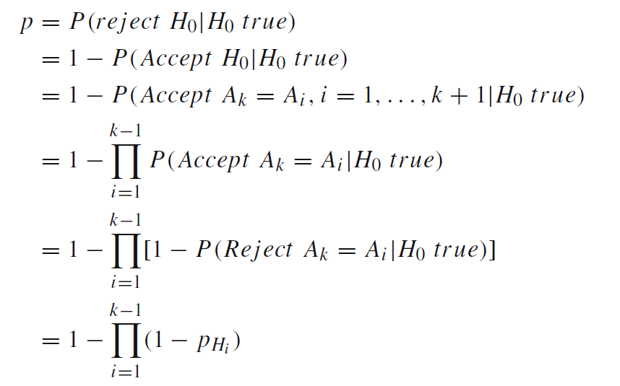
A Case Study: Performing Pairwise Comparisons
The true statistical signification for combining pairwise comparisons is given by

Slide 47
Data Sets and Proper Statistical Analysis of Data Mining Techniques
Data Sets and Partitions
Using Statistical Tests to Compare Methods
  Conditions for the Safe Use of Parametric Tests
  Normality Test over the Group of Data Sets and Algorithms
  Non-parametric Tests for Comparing Two Algorithms in Multiple Data Set Analysis
  Non-parametric Tests for Multiple Comparisons Among More than Two Algorithms

Slide 48
Non-parametric Tests for Multiple Comparisons Among
More than Two Algorithms
Multiple comparison procedures are designed for allowing the FWER to be fixed
They take into account all the influences that can exist within the set of results for each algorithm.

Slide 49
Non-parametric Tests for Multiple Comparisons Among
More than Two Algorithms
One of the most frequent situations where the use of statistical procedures is requested is in the joint analysis of the results achieved by various algorithms
The groups of differences between these methods (also called blocks) are usually associated with the problems met in the experimental study.

Slide 50
Non-parametric Tests for Multiple Comparisons Among
More than Two Algorithms
In a multiple problem comparison, each block corresponds to the results offered for a specific problem.
When referring to multiple comparisons tests, a block is composed of three or more subjects or results
  Each one corresponding to the performance evaluation of the algorithm for the problem

Slide 51
Friedman Test
The Friedman test is a nonparametric analog of the parametric two-way analysis of variance
It can be used to answer the following question:
  In a set of k samples (where k ≥ 2), do at least twoof the samples represent populations with different median values?
The Friedman test is the analog of the repeated measures ANOVA

Slide 52
Friedman Test
The null hypothesis for Friedman’s test states equality of medians between the populations
The alternative hypothesis is defined as the negation of the null hypothesis, so it is nondirectional.

Slide 53

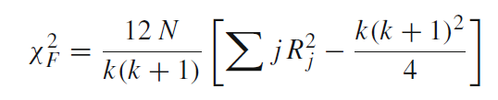
Friedman Test
The Friedman test method is described as follows:
  It ranks the algorithms for each data set separately, the best performing algorithm getting the rank of 1, the second best rank 2, and so on.
  In case of ties average ranks are assigned
  The Friedman test compares the average ranks of algorithms,
  The Friedman statistic is
χ²_{F} is distributed according to a χ² distribution with k−1 degrees of freedom, when n and k are big enough (as a rule of a thumb, n > 10 and k > 5)

Slide 54
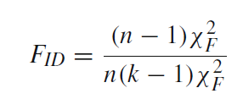
Iman–Davenport test
Iman and Davenport proposed a derivation from the Friedman statistic
This last metric often produces a conservative effect not desired.
The proposed statistic is
which is distributed according to an F distribution with k-1 and (k-1)(N-1) degrees of freedom

Slide 55
Iman–Davenport test
A drawback of the ranking scheme employed by the Friedman test is that it allows for intra-set comparisons only
When the number of algorithms for comparison is small this may pose a disadvantage since inter-set comparisons may not be meaningful
The method of aligned ranks for the Friedman test overcomes this problem

Slide 56
Post-hoc procedures
The rejection of the null hypothesis in both tests described above does not involve the detection of the existing differences among the algorithms compared.
They only inform us of the presence of differences among all samples of results compared
In order to conducting pairwise comparisons within the framework of multiple comparisons, we can proceed with a post-hoc procedure

Slide 57
Post-hoc procedures
A control algorithm (maybe a proposal to be compared) is usually chosen.
Then, the post-hoc procedures proceed to compare the control algorithm with the remain k − 1 algorithms.
In the following, we describe three post-hoc procedures: Bonferroni-Dunn’s, Holm and Hochberg procedures.

Slide 58
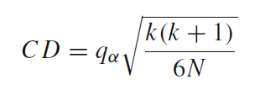
Bonferroni-Dunn’s procedure
It is similar to Dunnet’s test for ANOVA designs
The performance of two algorithms is significantly different if the corresponding average of rankings is at least as great as its critical difference (CD).
The value of q_{α} is the critical value of Q for a multiple non-parametric comparison with a control

Slide 59
Holm procedure
For contrasting the procedure of Bonferroni-Dunn, we dispose of a procedure that sequentially checks the hypotheses ordered according to their significance.
We will denote the p-values ordered by p1, p2, …, in the way that p1 ≤ p2 ≤ …≤ pk.
Holm’s method compares each pi with α/(ki) starting from the most significant p-value

Slide 60

Holm procedure
If p1 is lower than α/(k1), the corresponding hypothesis is rejected and it leaves us to compare p2 with α/(k2)
If the second hypothesis is rejected, we continue with the process
As soon as a certain hypothesis can not be rejected, all the remaining hypotheses are maintained as supported
The statistic for comparing the i algorithm with the j algorithm is:

Slide 61
Hochberg procedure
It is a step-up procedure thatworks in the opposite direction to Holm’s method
It compares the largest p-value with the next largest with α/2 and so forth until it encounters a hypothesis it can reject
All hypotheses with smaller p values are then rejected as well
Hochberg’s method is more powerful than Holm’s

Slide 62
Post-hoc procedures
The post-hoc procedures described above allow us to know whether or not a hypothesis of comparison of means could be rejected at a specified level of significance α.
It is also very interesting to compute the p-value associated to each comparison
We can know whether two algorithms are significantly different and also get a metric of how different they are.

Slide 63
Post-hoc procedures
We will describe the method for computing these exact p-values for each test procedure, which are called “adjusted p-values”
  The adjusted p-value for BonferroniDunn’s test (also known as the Bonferroni correction) is calculated by p_{Bon f} = (k − 1)p_{i} .
  The adjusted p-value for Holm’s procedure is computed by p_{Holm} = (k − i )p_{i} .
    It will not be possible to find an adjusted p-value for the hypothesis i lower than that for the hypothesis j , j < i .
    In this case, the adjusted p-value for hypothesis i is set equal to the p-values associated to the hypothesis j .
  The adjusted p-value for Hochberg’s method is computed with the same formula as Holm’s but to achieve the opposite
    It will not possible to find an adjusted p-value for the hypothesis i lower than for the hypothesis j , j > i .

Slide 64
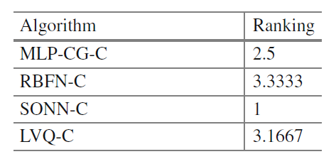
A Case Study: Performing Multiple Comparisons
We carry out a toy example on the analysis of a multiple comparison using MLP, RBFN, SONN and LVQ.
First we show the ranks obtained by each algorithm for Friedman test

Slide 65
A Case Study: Performing Multiple Comparisons
We can observe that SONN is the algorithm with the lowest rank and hence will act as the control algorithm.
  Friedman statistic (distributed according to chi-squared with 3 degrees of freedom): 12.2. p-value computed by Friedman Test: 0.006729.
  Iman and Davenport statistic (distributed according to F-distributionwith 3 and 15 degrees of freedom): 10.517241. p-value computed by Iman and Daveport Test: 0.000561296469.

Slide 66
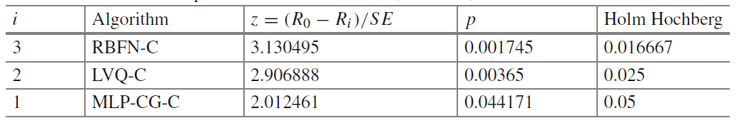
A Case Study: Performing Multiple Comparisons
In our case, both Friedman’s and Iman Davenport’s tests indicate that significant differences in the results are found in the three validations used in this study
A post-hoc statistical analysis is required
We choose the best performing method, SONN, as the control method for comparison
The unadjusted p-values for each algorithm when compared to SONN follow

Slide 67
A Case Study: Performing Multiple Comparisons
By computing Bonferroni-Dunn’s CD those hypotheses that have an unadjusted p-value ≤ 0.016667 are rejected.
By using the z value indicated for Holm’s and Hochberg’s procedures, we can observe that they reject those hypotheses that have an unadjusted p-value ≤ 0.05.
The reader may notice that Bonferroni-Dunn’s is not able to reject the null-hypothesis for SONN versus MLP, while Holm’s and Hochberg’s are able to reject all null-hypothesis due to their higher statistical power.

Slide 68
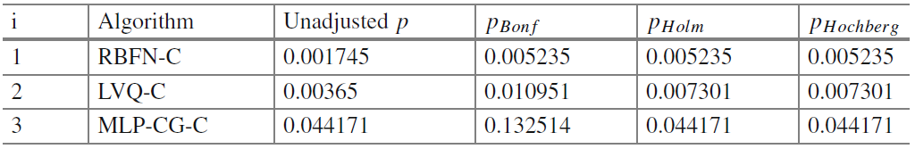
A Case Study: Performing Multiple Comparisons
The adjusted p-values for the post-hoc methods make searching for critical differences unnecessary
Taking a significance level of α = 0.05 we can observe that the conclusions obtained from the unadjusted p-values table are the same than those obtained in the following table with the adjusted p-values
The user only needs to observe those adjusted p-values that fall under the desired α significance level.

